Slide 1
Diabetes Prediction using PIMA Indians Dataset
Emre Hakan Erdemir
Ömer Faruk Aydın

Slide 2
Outline
Introduction
Why it is needed
Dataset Explanation
Preprocessing Steps
Model’s / Results
Related Studies

Slide 3
Diabetes
It is a chronic disease that has many contributors
Type 1 diabetes which often develops during childhood
Types 2 diabetes which often develops during adulthood
Gestational diabetes which develops during pregnancy

Slide 4
What is the point?
Early detection can help with timely interventions
Resource management
Understanding the factors that contribute to the disease

Slide 5
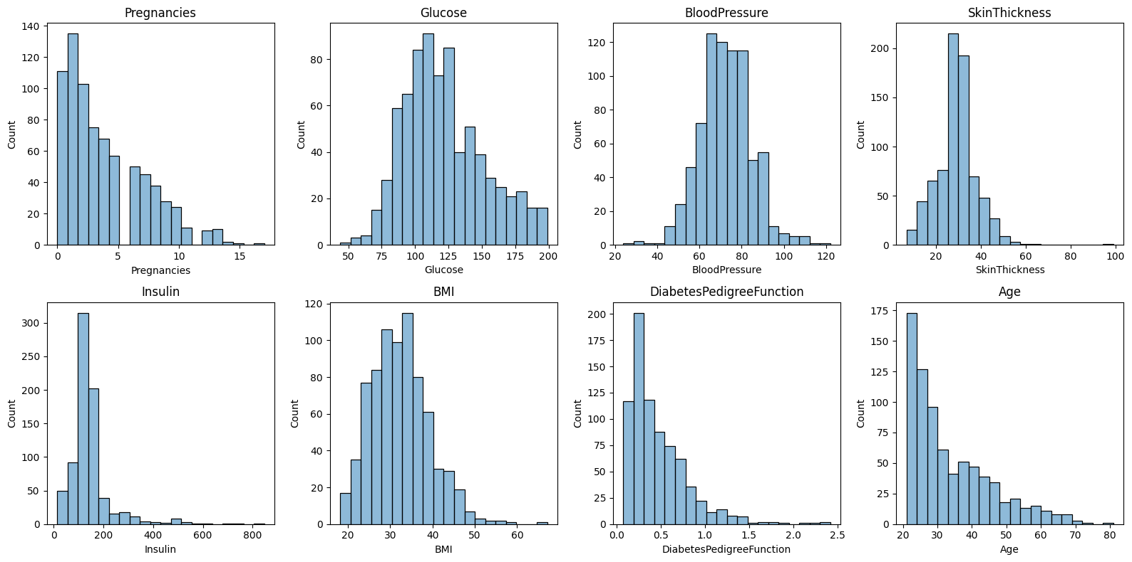
Our Dataset – PIMA Indians Dataset from Kaggle

Slide 6
Challenges with the data

Slide 7
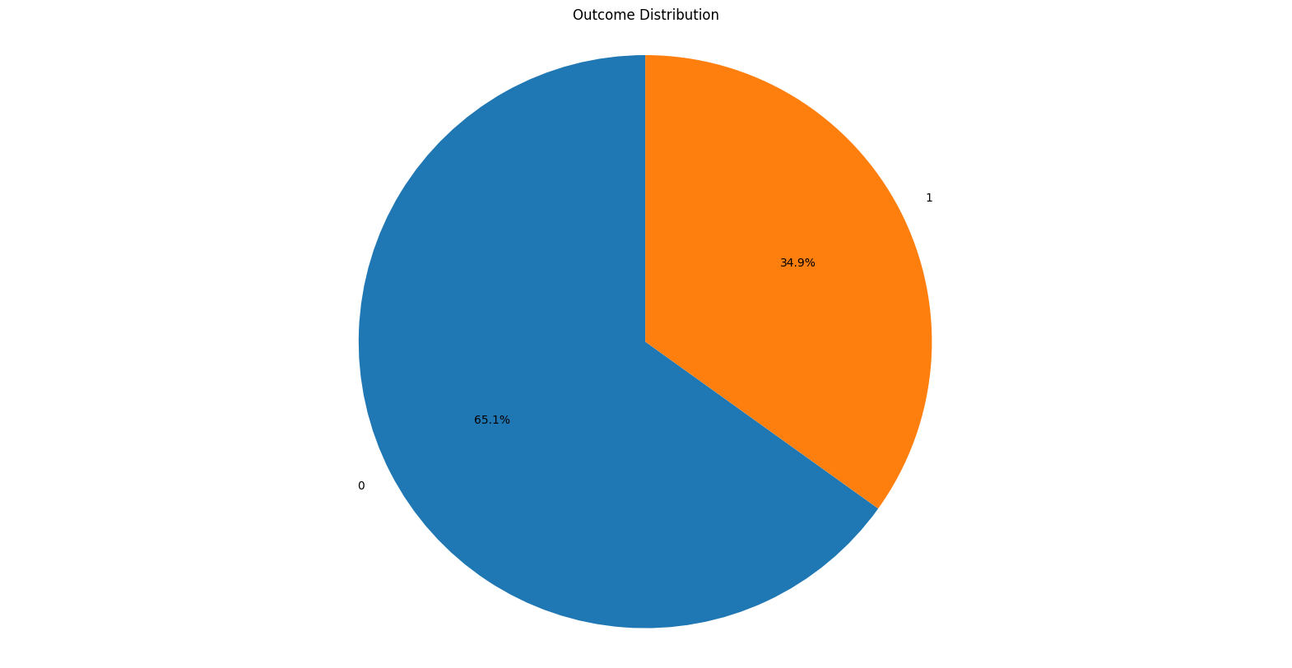
The Outcome Distribution
Notes:
Skewed towards non diabetic

Slide 8
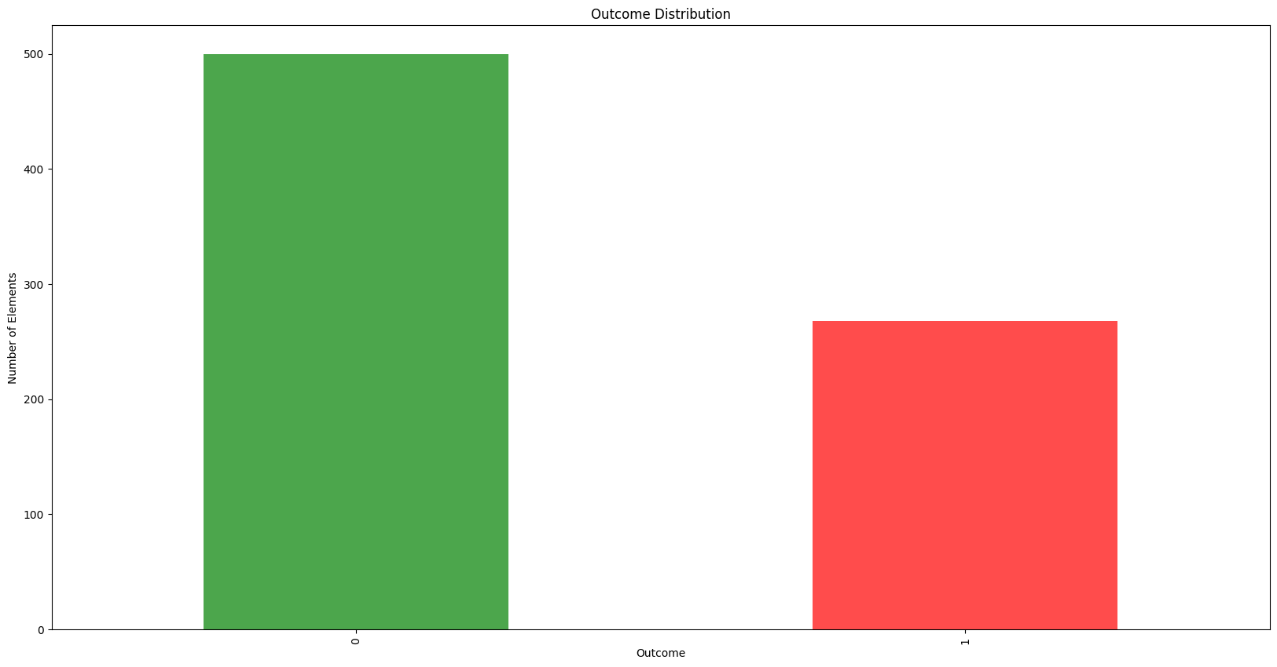

Slide 9
Related Works
There are many projects and articles written about classifying diabetes with this dataset, However the data was generally considered clean and optimized and they didn't emphasize too much on the preprocessing phase.

Slide 10
Preprocessing Steps

Slide 11
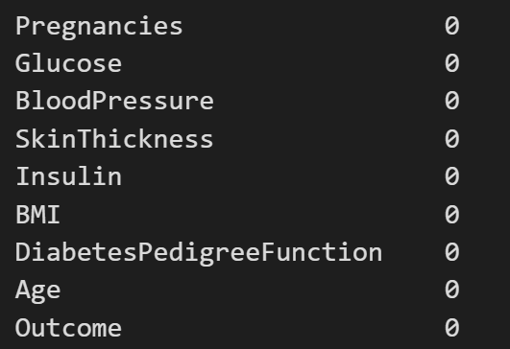
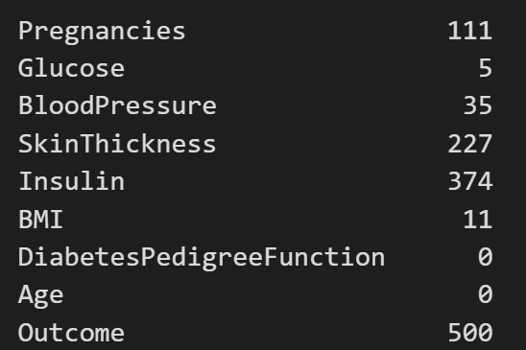
Null Values for each column
0 Values for each column

Slide 12
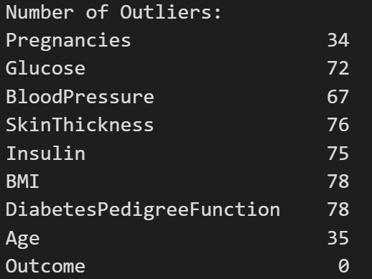
Outliers
By setting the lower quantile 0.05
and upper quantile 0.95 we can find the outliers

Slide 13
We filled the 0 values of the columns with the median based on the outcome
We capped the outliers to a max and min range

Slide 14
Models

Slide 15
Decision Trees
The tree recursively splits the dataset based on features, choosing the feature that provides the best separation according to a certain criterion
Easy to interpret!

Slide 16
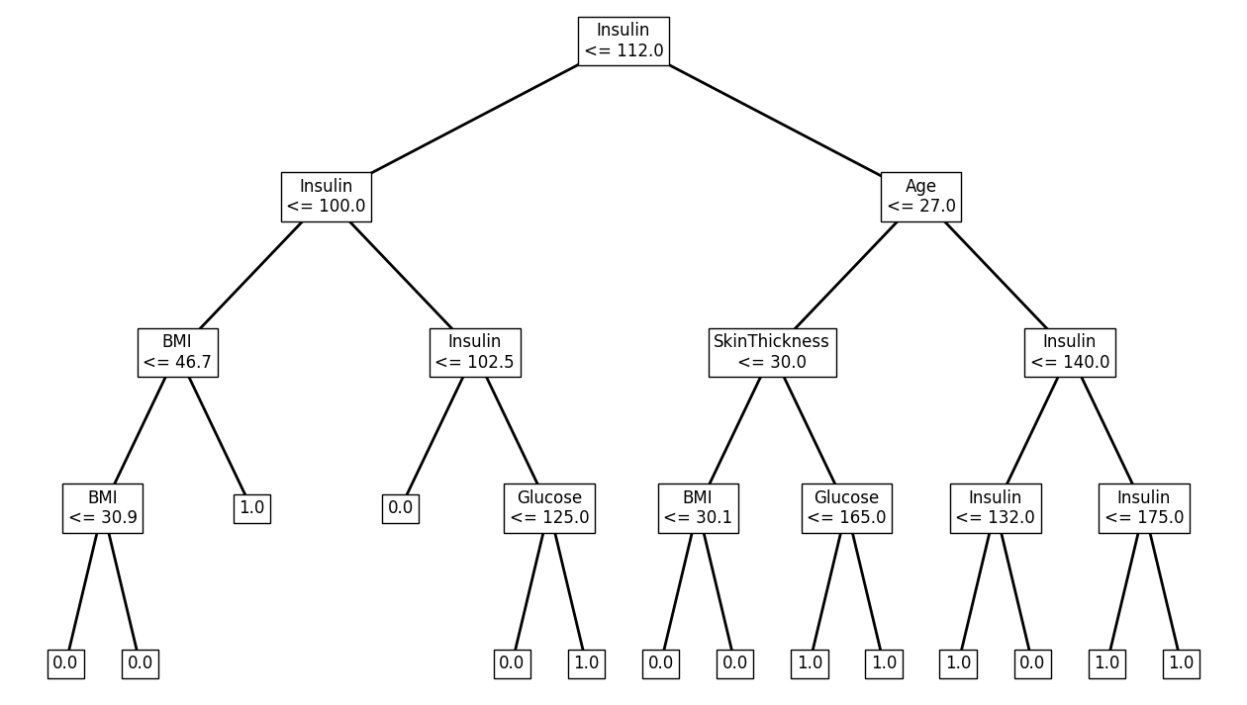
An example decision tree from our dataset

Slide 17
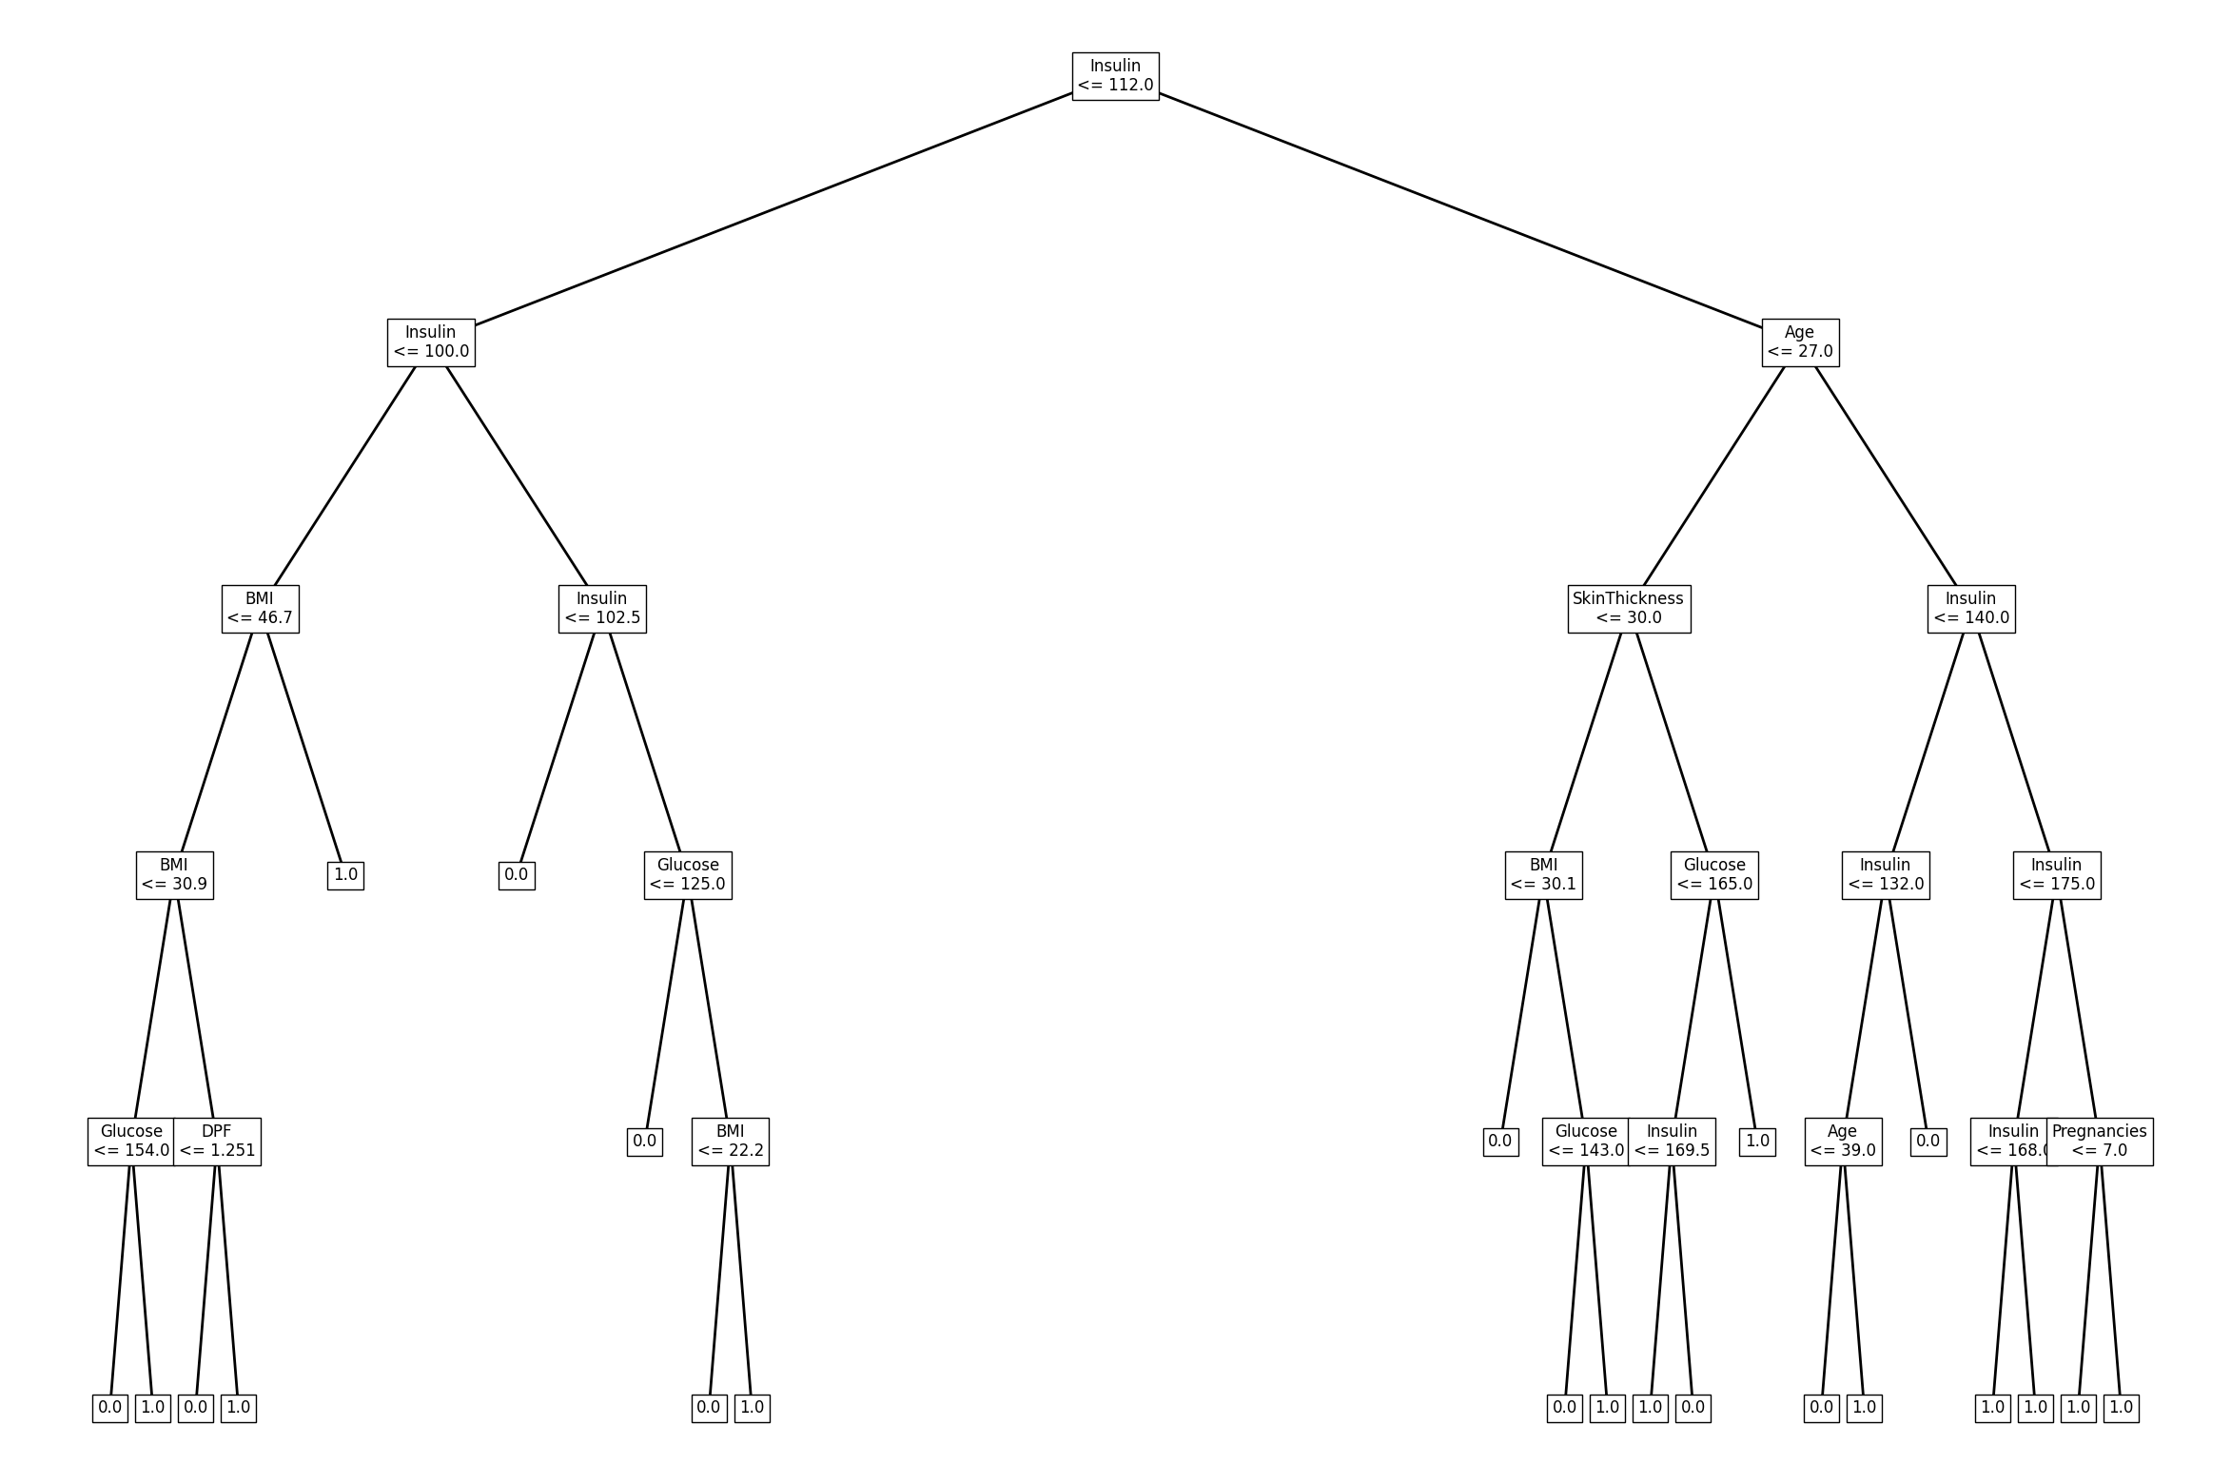
The Best Performing Decision Tree (Height 5)

Slide 18
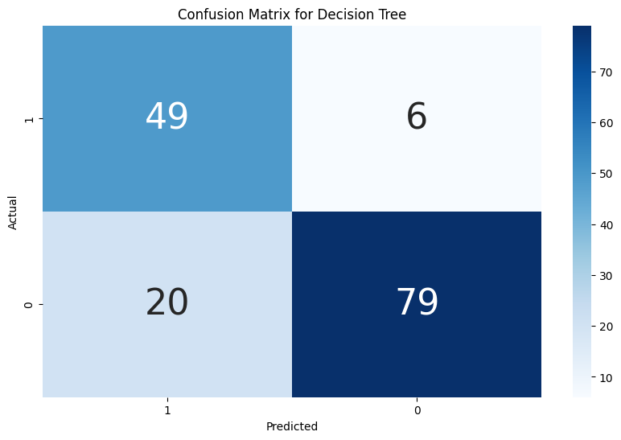
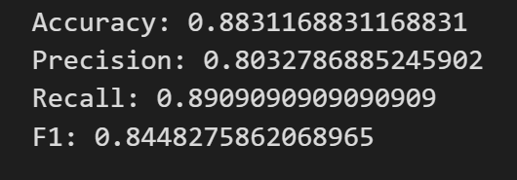
Results from the Decision Tree

Slide 19
Random Forest
They are an ensemble learning method that combines multiple decision trees to create a more accurate model by majority voting
At each tree creation, only a subset of the data is considered

Slide 20
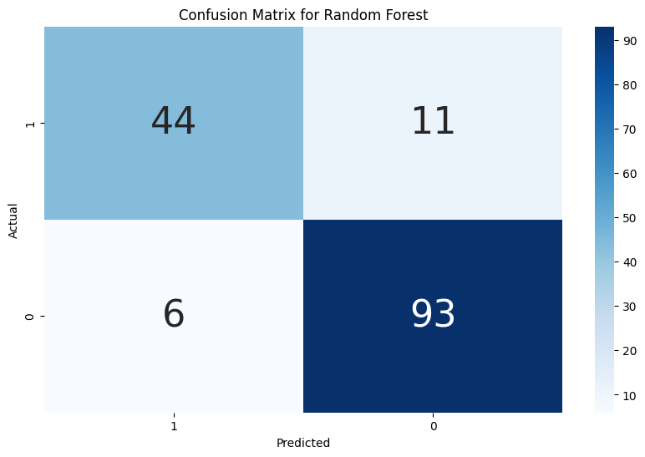
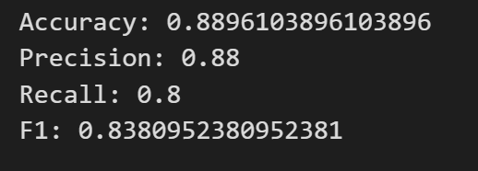
Results for the Random Forest algorithm

Slide 21
Custom Logistic Regression
# Custom Logistic Regression Model
LR_Model = LogisticRegression(
learning_rate=0.0001, num_iterations=1000)
LR_Model.fit(X_train, y_train)

Slide 22
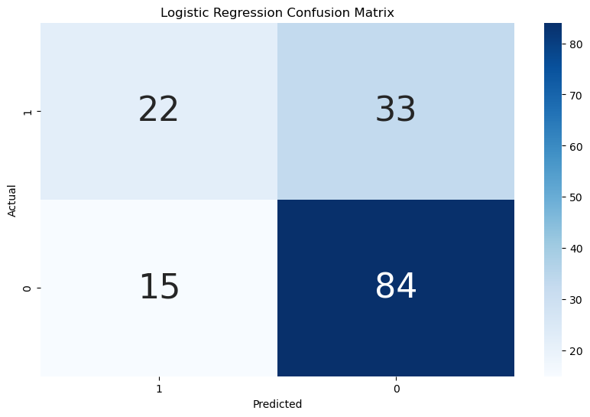
Custom Logistic Regression
Accuracy: 0.6883116883116883 Precision: 0.5945945945945946 Recall: 0.4
F1: 0.4782608695652174

Slide 23
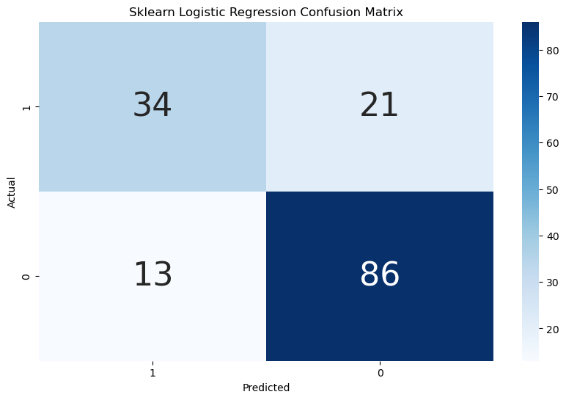
Sklearn Logistic Regression
Accuracy: 0.7792207792207793 Precision: 0.723404255319149 Recall: 0.6181818181818182
F1: 0.6666666666666667

Slide 24
Multilayer Perceptron
# Model architecture
self.model = nn.Sequential(
nn.Linear(input_size, hidden_size),
self.activation,
nn.Linear(hidden_size, output_size),
nn.LogSoftmax(dim=1)
)

Slide 25
Multilayer Perceptron Parameters
# Create the activation function
if activation == "relu":
self.activation = nn.ReLU()
elif activation == "sigmoid":
self.activation = nn.Sigmoid()
elif activation == "tanh":
self.activation = nn.Tanh()
else:
raise ValueError("Invalid activation function")
# Create the optimizer
if optimizer == "adam":
self.optimizer = optim.Adam(
self.parameters(), lr=self.learning_rate)
elif optimizer == "sgd":
self.optimizer = optim.SGD(
self.parameters(), lr=self.learning_rate)
else:
raise ValueError("Invalid optimizer")

Slide 26
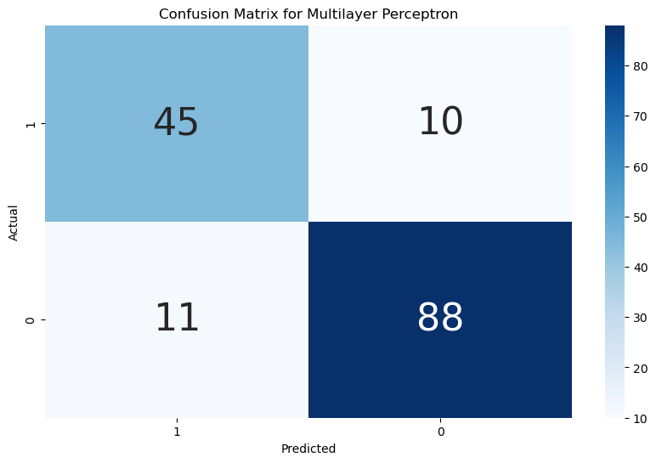
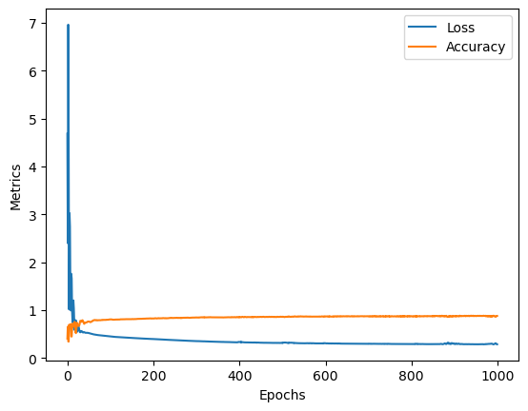
Multilayer Perceptron
Accuracy: 0.8831168831
Precision: 0.877551020
Recall: 0.78181818181
F1: 0.8269230769230769

Slide 27
Conclusion
# Decision Tree
Accuracy: 0.8831
Precision: 0.8032
Recall: 0.8909
F1: 0.8448
# Random Forest
Accuracy: 0.8896
Precision: 0.88
Recall: 0.8
F1: 0.8380
# Logistic Regression
Accuracy: 0.7792
Precision: 0.7234
Recall: 0.6181
F1: 0.6666
# Multilayer Perceptron
Accuracy: 0.8831
Precision: 0.8775
Recall: 0.7818
F1: 0.8269

